Slide 1
Level 6 Group 3 Beta Presentation
River Chick
Michael Curtis
Ryan Manthorp
Ogheneochuko Ideh

Slide 2

Pocket Planets: Game specification
Projected Demographic 16+/Students, commuters
Casual & Achieving Players (Bartle, 1996)
Player Psychograph
Marc age 17
College student
Commutes everyday
Interest in Sci fi & Management games
Low personal income

Slide 3
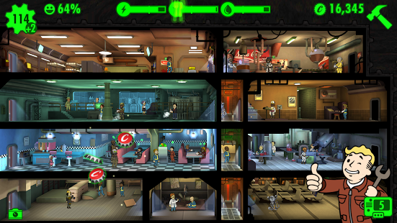
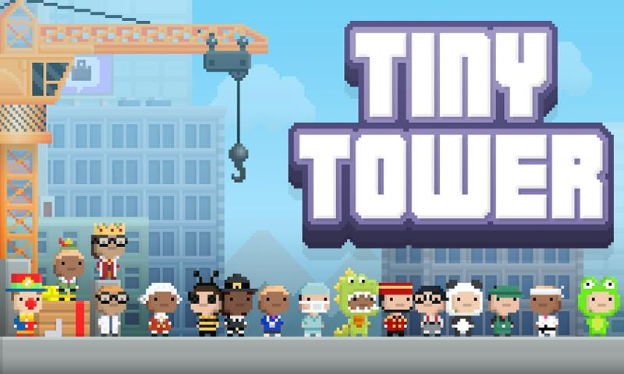
Pocket Planets: Game specification
Genre Managerial
Idle
Platform Android, IOS
Similar Titles

Slide 4
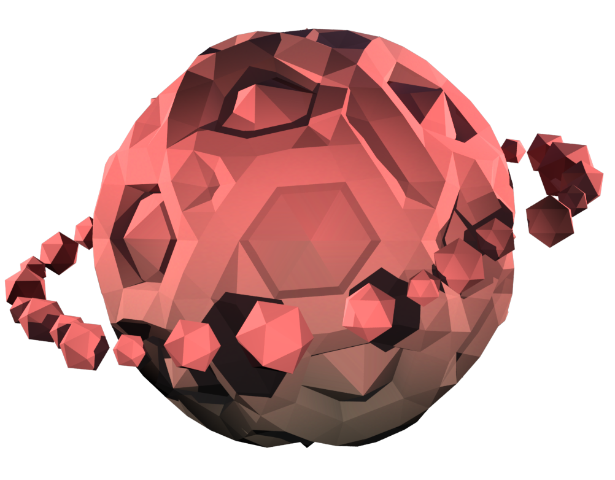
Video Footage

Slide 5
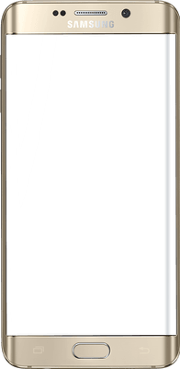
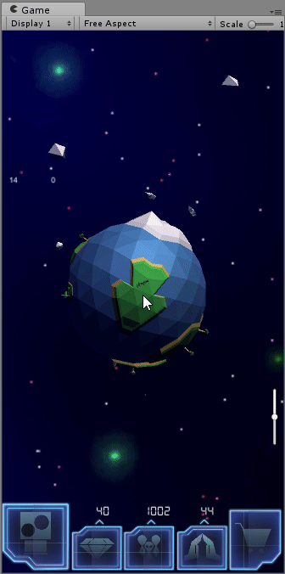
Beta Features
Resource Management
Fling asteroids to gain wealth and lose population.
Gain population and faith overtime.
Population and Faith increases over time.
Faith grows faster when wealth and population are balanced.

Slide 6
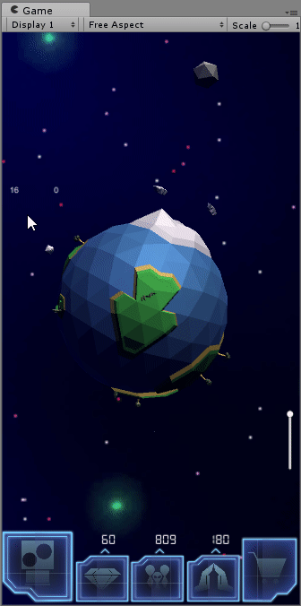
Features
Asteroid Chain
Shows all upcoming asteroids.
See values of incoming asteroids.
Informs player of duration before arrival.

Slide 7
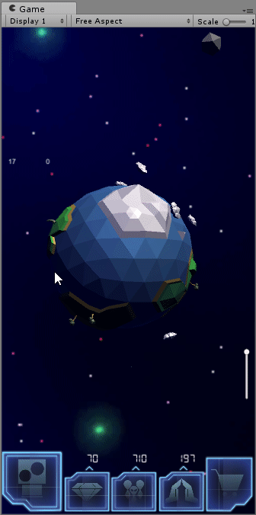
Features
Store/Gacha
Spend Faith to recieve a random vanity item
Buy cosmic dust with real money to buy specific items
Customize the planet with vanity items

Slide 8
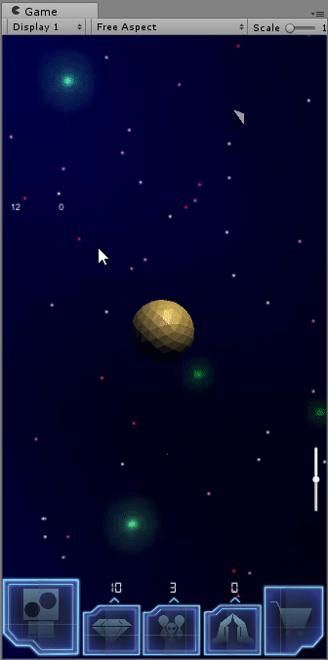
Features
Refresh
Once the planet has enough faith, the refresh ability is enabled.
A new planet is gained.
Vanity items will be reserved for futher use.
A permenant boost will be added to the population growth.
This can be done several times.

Slide 9
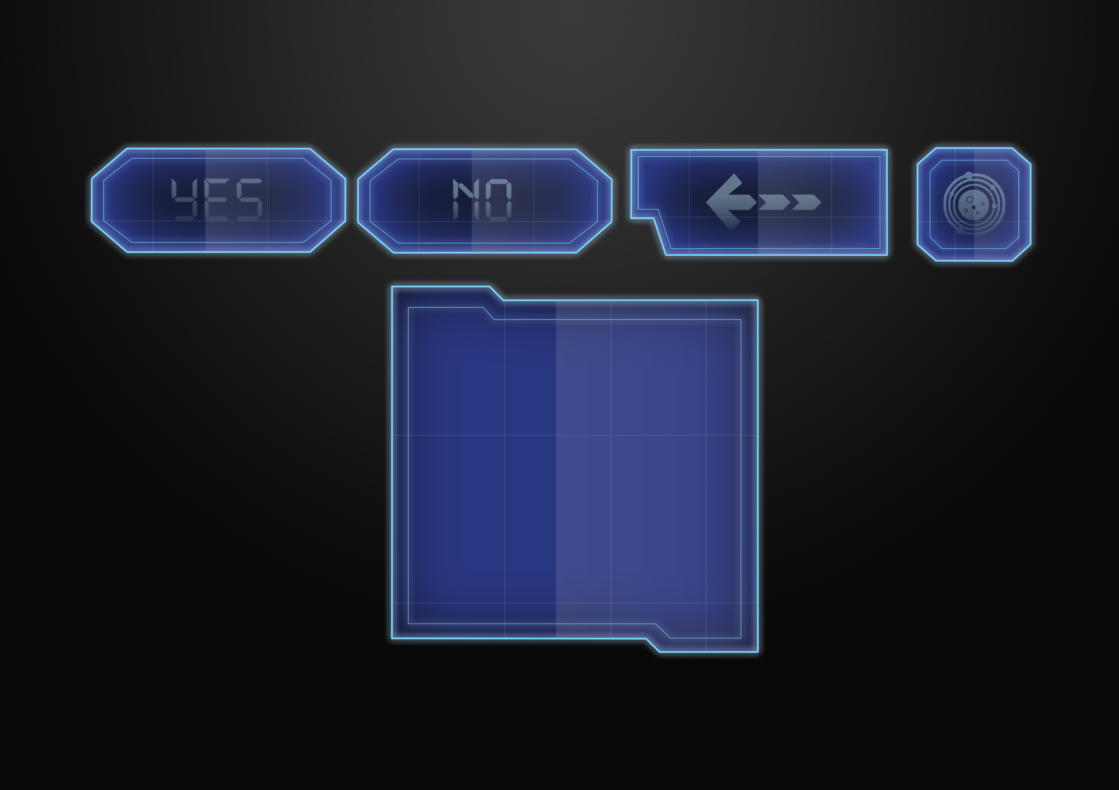
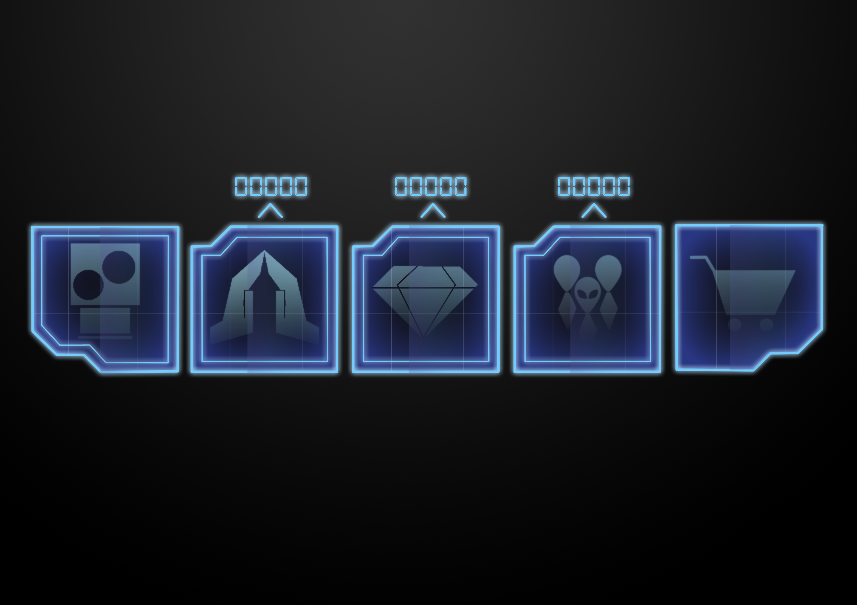
Game UI

Slide 10
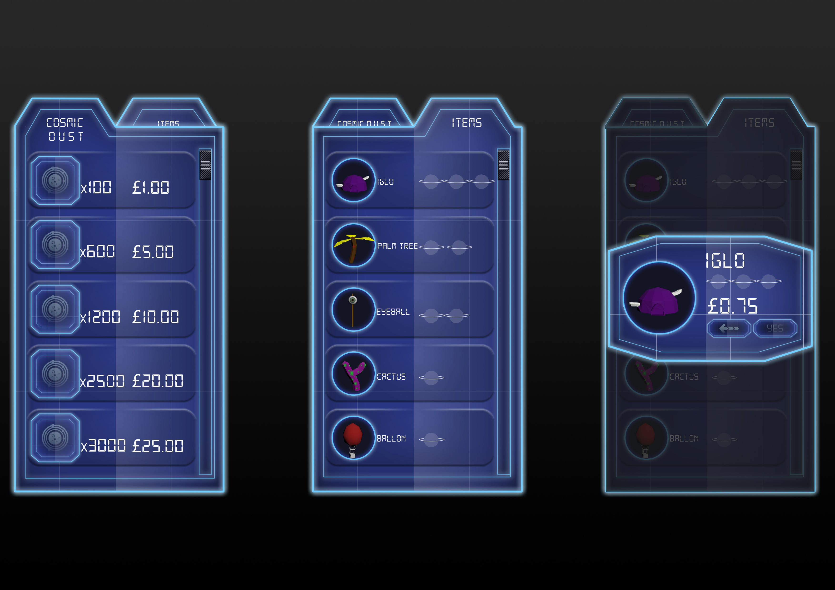
Store UI

Slide 11
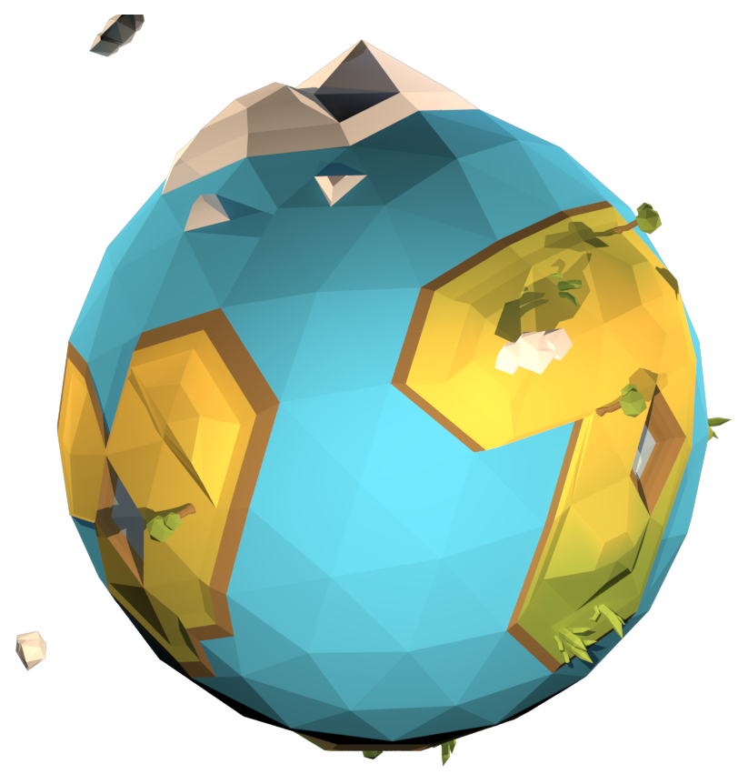
Game Engine
In order to put more work into coding we are changing game engine
We are moving from Unity to Unreal
Significant Progress has already been made in unreal

